Slide 1
MESH ANALYSIS
Dr.T.YUVAPRIYA
ASSISTANT PROFESSOR
SELECT

Slide 2
MESH ANALYSIS
Mesh and nodal analysis are two basic important techniques used in finding solutions for a network.
The suitability of either mesh or nodal analysis to a Methods of Analysing Circuits 2.21 particular problem depends mainly on the number of voltage sources or current sources.
If a network has a large number of voltage sources, it is useful to use mesh analysis; as this analysis requires that all the sources in a circuit be voltage sources.

Slide 3
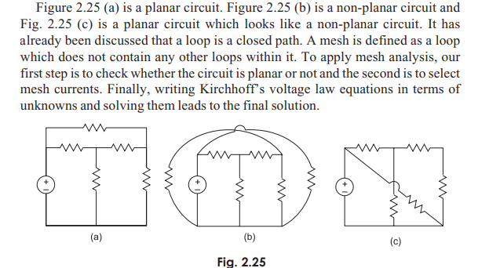

Slide 4
Therefore, if there are any current sources in a circuit they are to be converted into equivalent voltage sources, if, on the other hand, the network has more current sources, nodal analysis is more useful. Mesh analysis is applicable only for planar networks.
For non-planar circuits mesh analysis is not applicable.
A circuit is said to be planar, if it can be drawn on a plane surface without crossovers. A non-planar circuit cannot be drawn on a plane surface without a crossover.

Slide 5
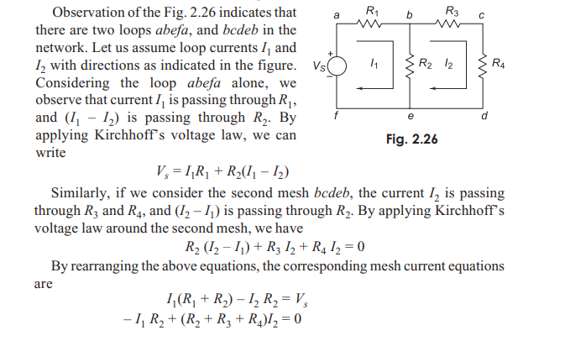

Slide 6
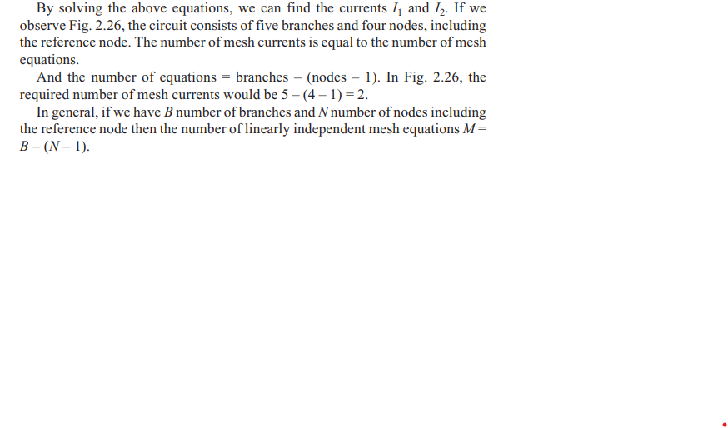

Slide 7
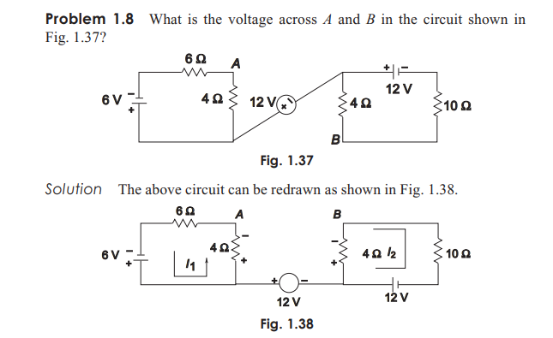

Slide 8
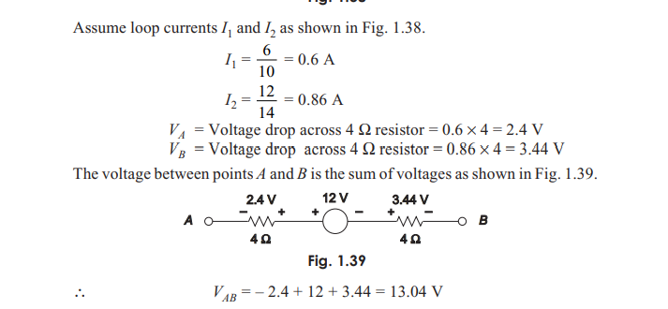

Slide 9
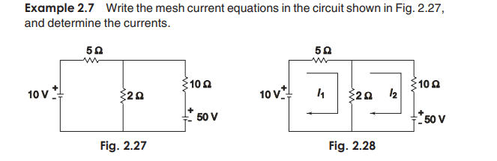

Slide 10
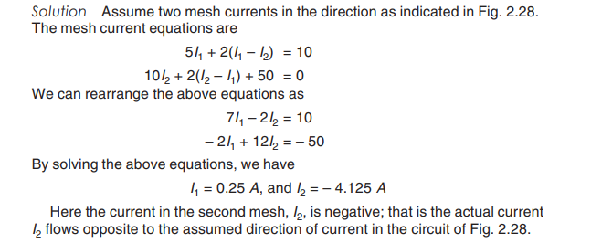

Slide 11
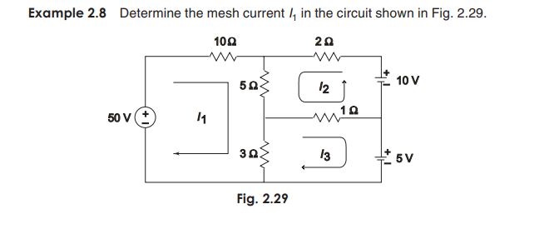

Slide 12
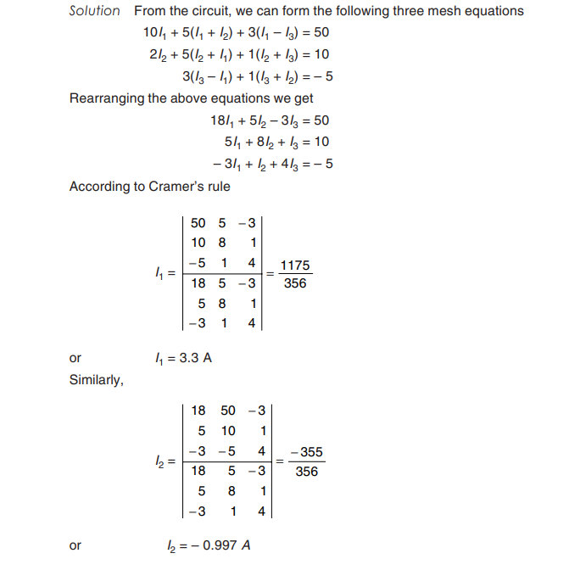

Slide 13
